Slide 1
AJAX
by Mykola Sotula

Slide 2
CAN REACT DO THIS?
React itself doesn’t have any allegiance to any particular way of fetching data.
In fact, as far as React is concerned, it doesn’t even know there’s a “server” in the picture at all.
React simply renders components, using data from only two places: props and state.
So therefore, to use some data from the server, you need to get that data into your components’ props or state.
You can complicate this process with services and data models (er, “build abstractions”) as much as you desire, but ultimately it’s just components rendering props and state.

Slide 3
HTTP LIBRARIES
Axios
Superagent
Fetch
Etc.

Slide 4
AXIOS
Axios is a very popular JavaScript library you can use to perform HTTP requests, that works in both Browser and Node.js platforms.
Using Axios has quite a few advantages over the native Fetch API:
supports older browsers (Fetch needs a polyfill)
has a way to abort a request
has a way to set a response timeout
has built-in CSRF protection
supports upload progress
performs automatic JSON data transformation
works in Node.js

Slide 5
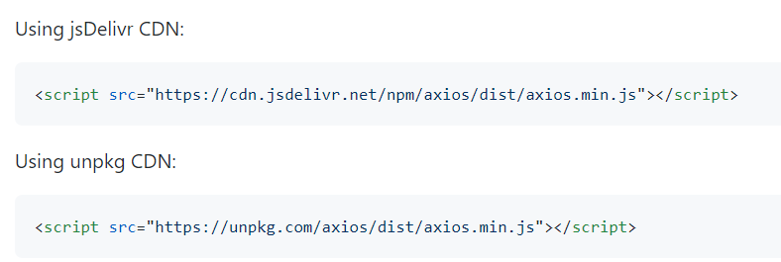

INSTALLATION
Or

Slide 6
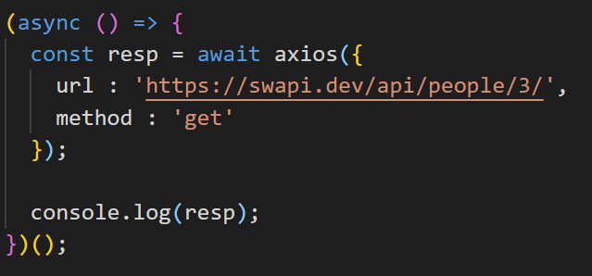
API
You can start an HTTP request from the axios object:
This returns a promise. You can use async/await to resolve that promise to the response object:

Slide 7
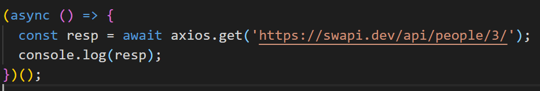
API METHODS
For convenience, you will generally use the methods
axios.get()
axios.post()
axios.delete()
axios.put()
axios.patch()
axios.options()

Slide 8
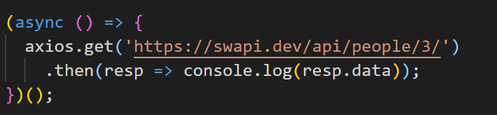
API PROMISE SYNTAX
If you don’t want to use async/await you can use the Promises syntax:

Slide 9
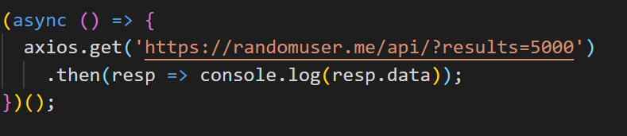
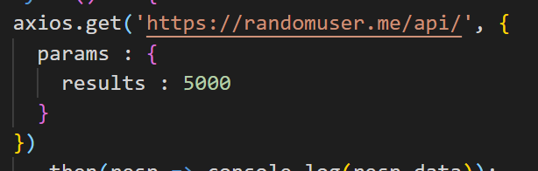
API GET PARAMETERS
With Axios you can perform this by using that URL
or you can use a params property in the options:

Slide 10
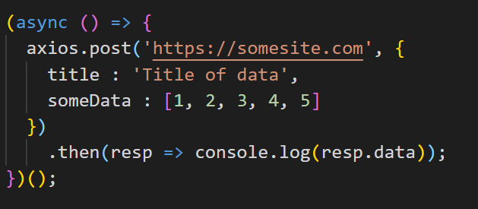
API POST REQUESTS
Performing a POST request is just like doing a GET request, but instead of axios.get, you use axios.post:

Slide 11
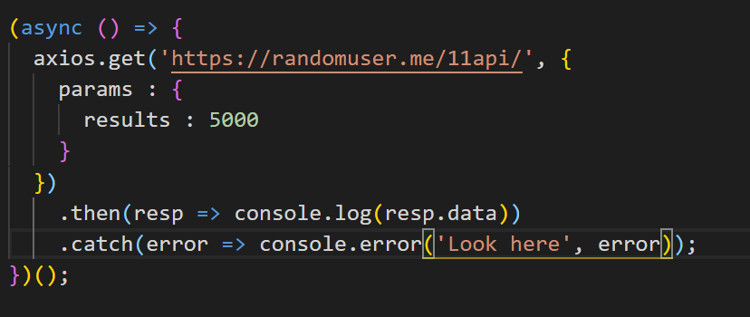
API ERROR HANDLING
Work with errors:

Slide 12


